Slide 1

Notes:
Final scene from movie "Bonhoeffer: Agent of Grace" http://www.youtube.com/watch?v=5XOexC-5ZOc

Slide 2

a Christian Pacifist who plotted a murder

Slide 3
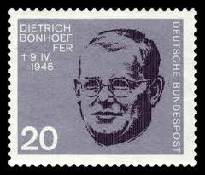
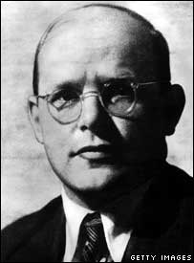
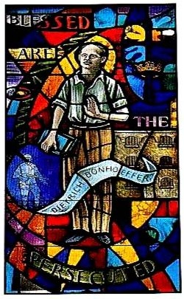

Slide 4

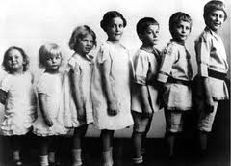
Born February 4th 1906 in Poland. His father was a doctor in Germany
He was a teacher at the University of Berlin
He became a priest in Germany

Slide 5

Adolf Hitler had become the leader in Germany
He hated ethnic minorities and especially Jewish people
He tried to create a ‘racially pure’ race in Germany where people like Jews gradually had their human rights taken away and were eventually killed.
Hitler had concentration camps built where Jewish people were taken and were killed in gas chambers or were shot. Some died from starvation.
Nuremberg Laws passed
Notes:
Show Nuremberg Laws Powerpoint with more information

Slide 6

When Hitler came to power in 1933, he charged the medical profession with the task of implementing a national program in race hygiene. The first key element was the enactment, in 1934, of a law permitting involuntary sterilization of feebleminded, mentally ill, epileptics, and alcoholics. The "marriage laws" of 1935 prohibited unions between "Aryans" and Jews, as well the eugenically unfit.
By the outbreak of WWII, in 1939, an estimated 400,000 people had been sterilized. However, in 1940 the need for hospital beds for wounded soldiers prompted a "final solution" for "lives not worth living." Psychiatrists and medical doctors identified more than 70,000 mental patients who were poisoned with carbon monoxide in extermination centres at psychiatric hospitals. Disabled babies were also killed as were other disabled adults
After gassing of mental patients ceased in 1941, medical and other personnel with euthanasia experience were reassigned to concentration camps in Poland, where hydrogen cyanide gas was used to kill Jews, gypsies, Slavs, and Social Democrats.
Notes:
http://www.eugenicsarchive.org/eugenics/topics_fs.pl?theme=41&search=&matches=

Slide 7

The Church in Germany, backed by the Pope Pius XI followed Hitler and only allowed ‘racially pure’/non Jewish people to be part of the Church
Bonhoeffer was one of the few Church leaders to stand up against Hitler
He taught that all people were equal and Christians should help the Jews
Notes:
http://defsi.typepad.com/deafening_silence/2009/02/valkyries-forgotten-man-dietrich-bonhoeffer.html

Slide 8

His friends wanted him to go to New York as war broke out, to teach in the universities there and continue to write his books.
He did go, but changed his mind. He thought ‘– how can I help German Christians re-build Germany after the war if I haven’t been there with them during the war.’
And so he returned to Germany

Slide 9

In 1940 he was recruited into the resistance against Hitler
Their aim was to assassinate Hitler and overthrow the Third Reich
He was also involved in trying to get Jewish Children out of Germany to escape the concentration camps

Slide 10

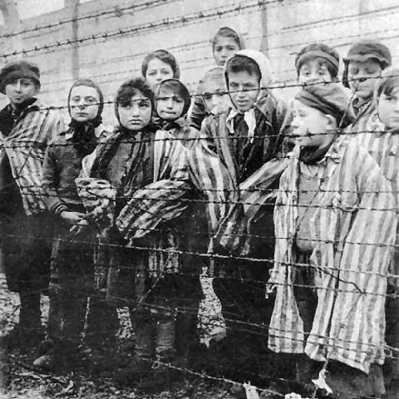
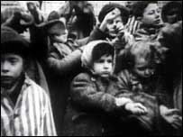

Slide 11

During this time he wrote a book called ‘Ethics’ where he talked about how a Christian could support murdering someone
He concluded that it was the duty of a Christian to confront evil.
“Christians are, therefore, faced with a dilemma: when assaulted by evil, they must oppose it through direct action. They have no other option. Any failure to act is simply to condone evil”.

Slide 12

He was a well known and well respected leader of the German Church
He believed in God and followed God’s commandments (e.g. do not murder, do not lie)
But he was asked to help in the plot to kill Hitler.
What should he do?
Jesus taught to fight for those who were being hurt or abused and to care for everyone.
The Golden Rule (treat others how your would want to be treated)
He believed that by standing up against evil, he was doing the right thing.
The greatest good for the greatest number

Slide 13

The most important thing he believed was that being a Christian was hard
If you truly put others first, and cared, you had to make some hard decisions
For him it meant risking his life in order to help others

Slide 14

He was executed April 3rd 1945, 7 days before Hitler committed suicide
His brother and brother-in-law were also killed alongside him

Slide 15
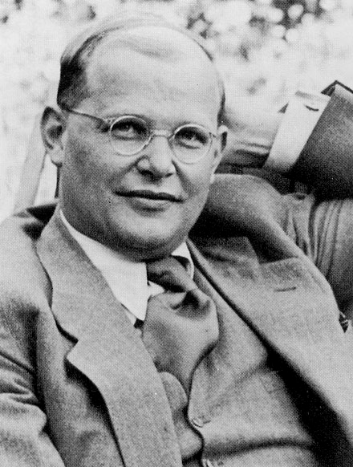
His final prison letter shows how strong is faith was: "This is the end, and, for me, the beginning of life."
He said it was important to not think about your self, but how future generations would live

Slide 16

It is better to do evil than be evil
It is better for a truthful person to tell a lie than a liar to tell the truth
He is saying that there is a difference between those who are evil and those who do evil
He saw Hitler as someone who was evil

